Slide 1
Wi-Fi Direct

Slide 2
INTRODUCTION
Wi-Fi Direct could be used to remotely connect to a wireless printer without requiring the printer to join an existing wireless network.
Guest Printing
Wi-Fi Direct is single-hop communication
two devices to establish a direct Wi-Fi connection without an intermediary wireless access point, router, or Internet connection.
Windows 7 does not directly support WiFi Direct.

Slide 3
Steps to perform Wifi Direct Printing
Turn on Wifi direct option in Printer
Add the printer through Printers and Scanners
Enter the WPS pin to connect to the printer
Perform the print option if the necessary drivers are available.

Slide 4
Video example 2nd video

Slide 5
What is WPS pin?
stands for wireless protected setup is a set of protocols to connect two devices securely over a wireless network
unique 8- digit number that is generated by the HP printer.

Slide 6
Advantages
The Wi-Fi peer-to-peer (P2P) APIs allow applications to connect to nearby devices
Direct Wireless Connectivity
Flexible and Versatile Applications
Secure Connectivity

Slide 7
Disadvantages
Slower Than Wired Connectivity
Connectivity Issues Due to Compatibility
Still Has Some Security Vulnerabilities

Slide 8
Embedded Web Server
Get the Wi-Fi Direct printer name and password.
Select your Wi-Fi Direct printer name from the list of networks, and then enter the password to connect to the printer.
Open the URL for EWS and follow the steps.

Slide 9
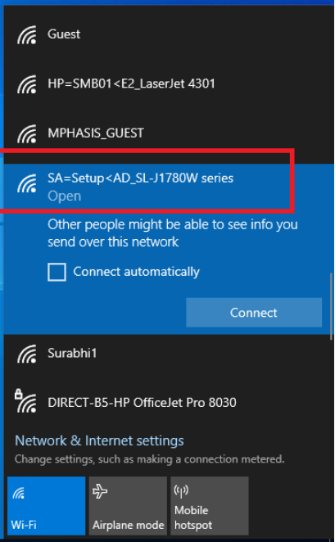

Slide 10
Functions
The following functions support the Wi-Fi Direct feature.
WFDCancelOpenSession - Indicates that the app wants to cancel a pending WFDStartOpenSession function that has not completed.
WFDCloseHandle - Closes a handle to the Wi-Fi Direct service.
WFDCloseSession - Closes a session after a previously successful call to the WFDStartOpenSession function.
WFDOpenHandle - Opens a handle to the Wi-Fi Direct service and negotiates a version of the Wi-FI Direct API to use.
WFDOpenLegacySession - Retrieves and applies a stored profile for a Wi-Fi Direct legacy device.
WFDStartOpenSession - Starts an on-demand connection to a specific Wi-Fi Direct device, which has been previously paired through the Windows Pairing experience.
WFDUpdateDeviceVisibility - Updates device visibility for the Wi-Fi Direct device address for a given installed Wi-Fi Direct device node.
WFD_OPEN_SESSION_COMPLETE_CALLBACK - Defines the callback function that is called by the WFDStartOpenSession function when the WFDStartOpenSession operation completes

Slide 11


